Slide 1


Win Prediction Analytics Data Science Pro-degree Project KPMG Knowledge Partner
DSP-60 Group 2
Jay Shah
Pratik Vichare
Pratik Bhosale
Manav Surve
Heena Cholera

Slide 2

Objectives
This project entails evaluating data from an IT consulting firm to evaluate the elements that influence the likelihood of getting a project. The organisation may prioritise its opportunities and dedicate resources to maximise its win rate and income by establishing a predictive model. The project will include data preprocessing, exploratory data analysis, feature selection, model selection, and performance evaluation. The purpose is to assist the organisation in making data-driven decisions and optimising its deal-winning strategy.

Slide 3

Data Overview and Description
Column Name | Description
Client Category | Industry in which the client works
Solution Type | The solution group the client requires
Deal Date | The date the opportunity was created
Sector | The sector for which the solution is to be provided
Location | Client location
VP Name | Sr. Manager or VP which is dealing with the client
Manager Name | Manager of the team working on the project
Deal Cost | The initial cost of the deal
Deal Status Code | Final status of the deal(won/lost)

Slide 4
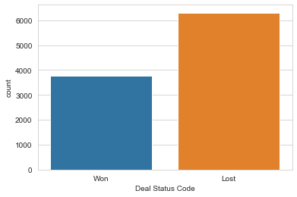
EDA: Deal Status Code Counts

Slide 5
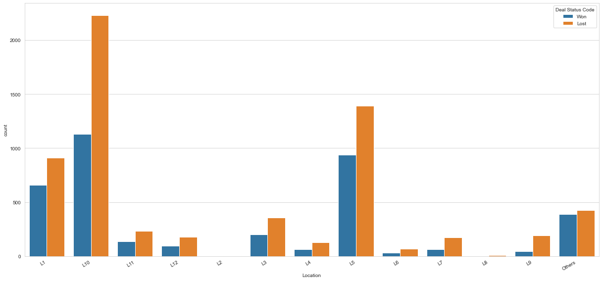
EDA: Location Counts wrt Deal Status Code

Slide 6
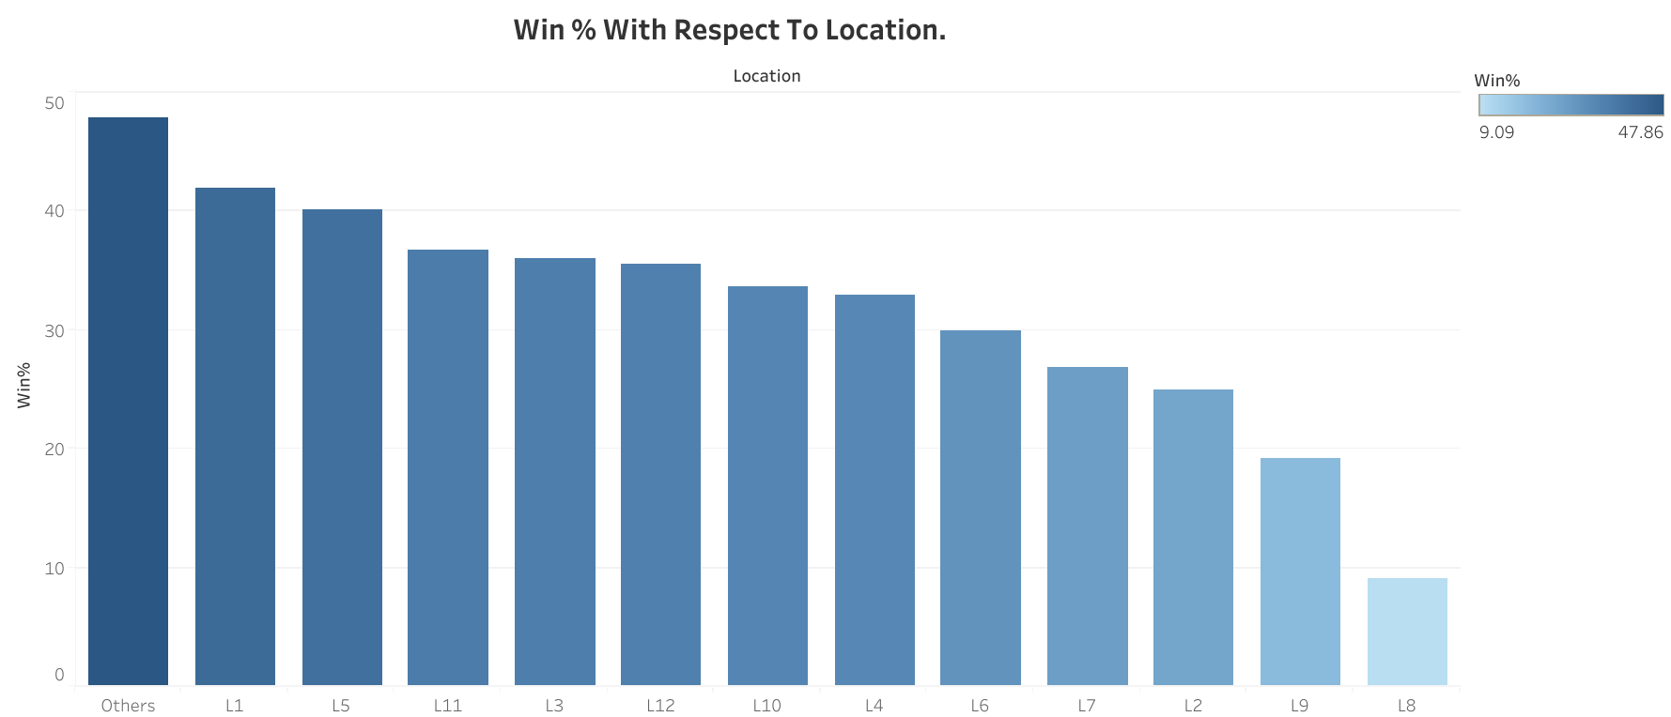

Slide 7
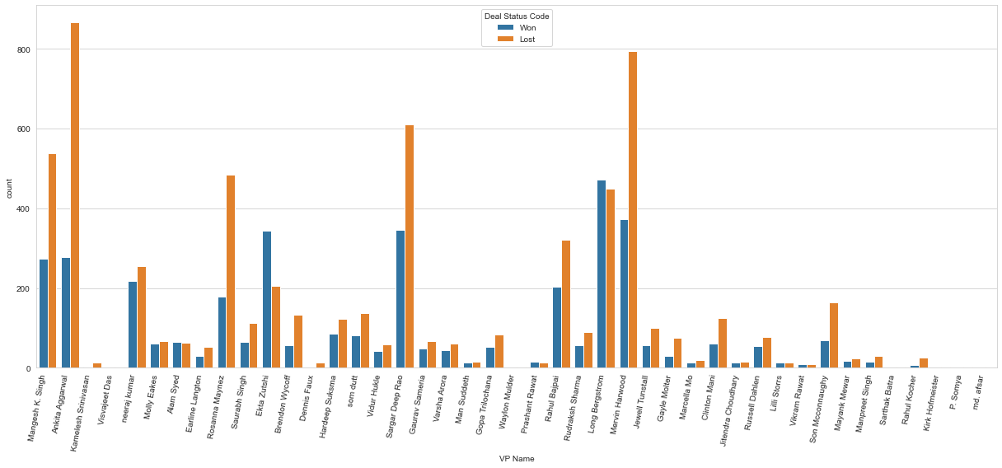
EDA: VP Names on Deal Status Code

Slide 8
Win % age of VP Name column
Deal Status Code VP Name | Lost | Won | Total | Win%
Ekta Zutshi | 206 | 344 | 550 | 62.545455
Prashant Rawat | 12 | 15 | 27 | 55.555556
Vikram Rawat | 8 | 9 | 17 | 52.941176
Long Bergstrom | 450 | 471 | 921 | 51.140065
Alam Syed | 62 | 64 | 126 | 50.793651
Molly Eakes | 66 | 60 | 126 | 47.619048
Lilli Storrs | 14 | 12 | 26 | 46.153846
neeraj kumar | 254 | 217 | 471 | 46.072187
Man Suddeth | 16 | 13 | 29 | 44.827586
Jitendra Choudhary | 16 | 12 | 28 | 42.857143

Slide 9
Win%age of Manager Name column
Deal Status Code Manager Name | Lost | Won | Total | Win%
Aastha Gandhi | 0 | 1 | 1 | 100.0
Anish Jonson | 0 | 1 | 1 | 100.0
Vaibhav Somaskandan | 0 | 2 | 2 | 100.0
Uzaar Ali | 0 | 1 | 1 | 100.0
Upendra Bhatt | 0 | 5 | 5 | 100.0
Taran Singh | 0 | 1 | 1 | 100.0
Sumita Verma | 0 | 2 | 2 | 100.0
Sumit Arora | 0 | 1 | 1 | 100.0
Sultan Khan | 0 | 1 | 1 | 100.0
Arti Bindra | 0 | 1 | 1 | 100.0

Slide 10
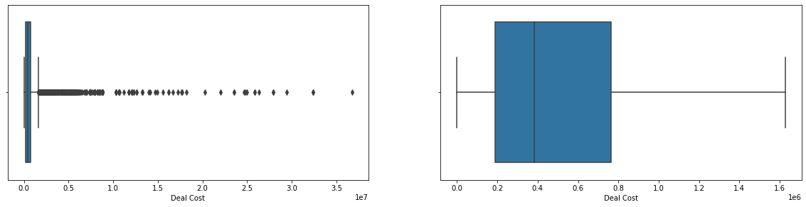
EDA: Deal Cost Box Plot
Deal Cost Variable With Outliers
Deal Cost Variable Without Outliers

Slide 11

LOGARITHMIC TRANSFORMATION
Log Transformation is used to make our Skewed Data(Deal Cost) more normal and balanced. It improves the linearity between our dependent and independent variables. It also boosts validity of our statistical analysis.
Log Transformation also de-emphasizes outliers. The idea is that taking the log of the data can restore symmetry to the data.

Slide 12

Data Encoding
We used Target Encoding to convert independent variables from Objects to Numerical.
We used Label Encoding to convert dependent variable from Objects to Numerical.
Target encoding involves replacing a categorical feature with average target value of all data points belonging to the category.

Slide 13
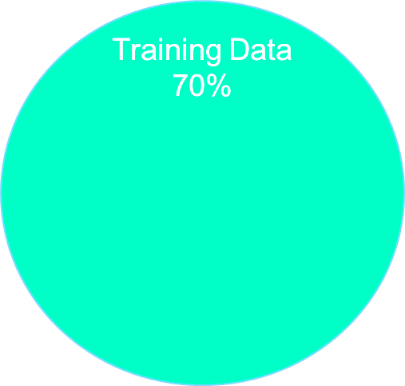
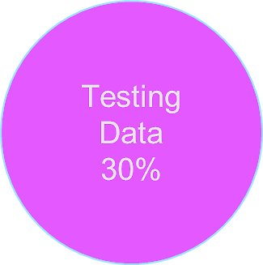

Splitting the data for Train & Test Model : Why Split ?
In machine learning, data splitting is typically done to avoid overfitting.
We need to split a dataset into train and test sets to evaluate how well our machine learning model performs
Splitting your dataset is essential for an unbiased evaluation of prediction performance
We need to split the data before Scaling to avoid Data Leakage.

Slide 14

Data Scaling
Input variables may have different units – that, in turn, may mean the variables have different scales.
Standardization requires that you know or are able to accurately estimate the mean and standard deviation of observed values.
Formula, :
Y= (X-Mean) /Standard Deviation
We used Standard Scaling technique to scale the data and assigned train and test variables before building a model.

Slide 15
Accuracy Score & Hyper Parameter
Accuracy Based On Each Model
Logistic Regression
72.81%
Random Forest
83.64%
To check how well the models performed, we used accuracy score.
Furthermore, to boost the accuracy of the model, we opted for various parameters and here we used Random Search CV.
XG-Boost
82.69%

Slide 16
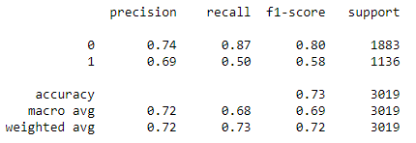
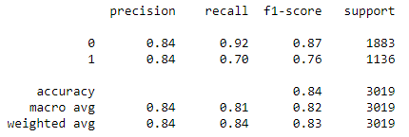
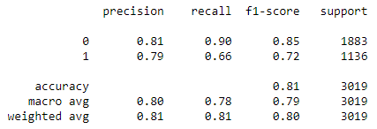
CLASSIFICATION REPORT FOR EACH MODEL
Logistic Regression
Random Forest
XG - Boost

Slide 17
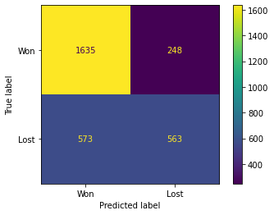
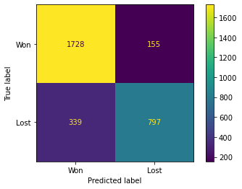
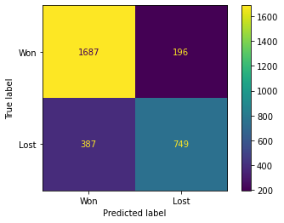
CONFUSION MATRIX FOR EACH MODEL
Logistic Regression
Random Forest
XG - Boost

Slide 18
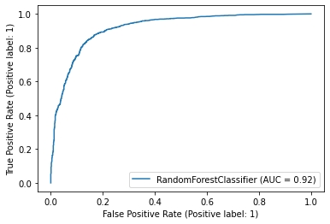
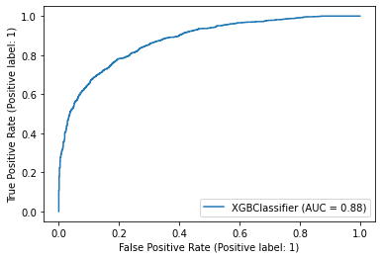
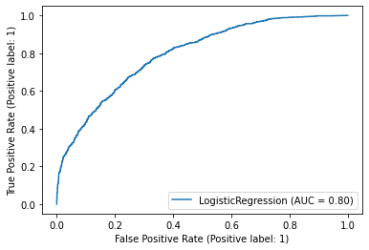
ROC Curve
Random Forest
XG - Boost
ROC (Receiver Operating Characteristics) curve is one of the most important evaluation metrics for checking any, specially, binary classification model’s performance. This curve plots two parameters:
True Positive Rate
False Positive Rate
It provides a graphical representation of a classifier’s performance, rather than a single value like most other metrics.
Logistic Regression

Slide 19

Testing and cross validation
After building our models we have move forward to evaluate it whether or model is a generalized model or not.
We used K-Fold Cross validation method to validate our model to check the performance.

Slide 20
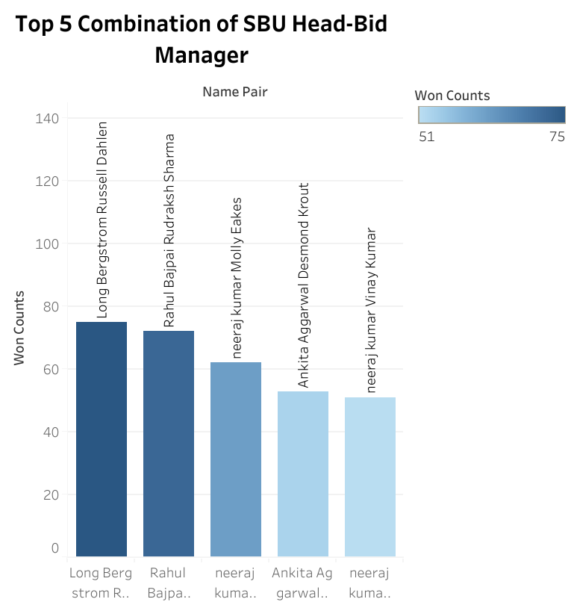
Top 5 Combination of SBU Head-Bid Manager

Slide 21

False Prediction Calculate The Loss Which The Company Will Face
We calculated that For every false prediction the loss which the company will face is 381677941.44

